Slide 1
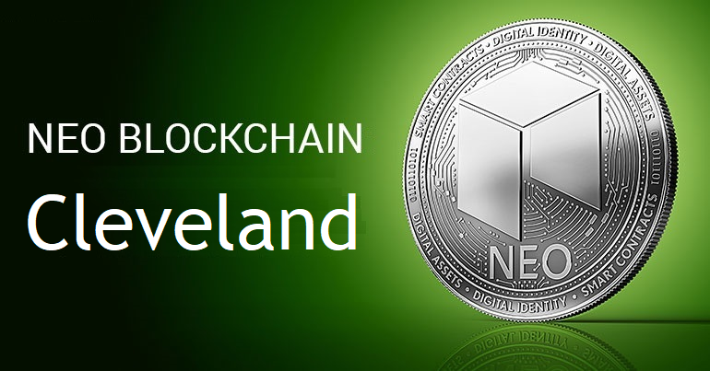
NEO Blockchain CLEVELAND
Welcome Neoxplorers!
“Genesis Block 0” Meetup – March 14, 2018
https://www.meetup.com/NEO-Blockchain-Cleveland/
neotoronto@outlook.com

Slide 2
Agenda
Introductions
What is NEO?
Why NEO?
NEO Resources
neo-windocs Project
Networking

Slide 3
Introductions
Lead Neoxplorer: Michael Herman E: mailto:neotoronto@outlook.com M: https://www.meetup.com/NEO-Blockchain-Cleveland G: https://github.com/mwherman2000/neo-windocs/events F: https://www.facebook.com/neotoronto/ T: https://www.twitter.com/neotoronto
Who are you?
Crytopinvestor?
Software Developer/Achitect?
Legal profession?
Financial services (convention)?

Slide 4
What is NEO Blockchain Cleveland?
NEO Blockchain Cleveland (https://www.meetup.com/NEO-Blockchain-Cleveland/) is a non-profit, community-based Meetup group for blockchain developers and architects interested in designing and creating Distributed Ledger Technology (DLT) (aka blockchain) solutions using the NEO Blockchain platform.
We call ourselves Neoxplorers
Meetup second Wednesday evening of each month
April 11, May 9, June 13, …
This meetup is a group that it is (currently) independent of the official NEO Project (https://github.com/neo-project) and COZ (https://github.com/CityOfZion/) projects. I'm looking forward to this changing in the future.
More importantly, NEO Blockchain Cleveland is what we want to make it!

Slide 5
Our Values as Neoxplorers
We operate like a blockchain
Decentralized
Community based
Consensus driven
Creators of value
Store value
Transfer value
Multi-disciplinary
Multi-application
Multi-technology
We behave like a blockchain
Robust
Reliable
Transparent
Smart
Open
Non-discriminatory
Participatory
Diversity
Committed

Slide 6
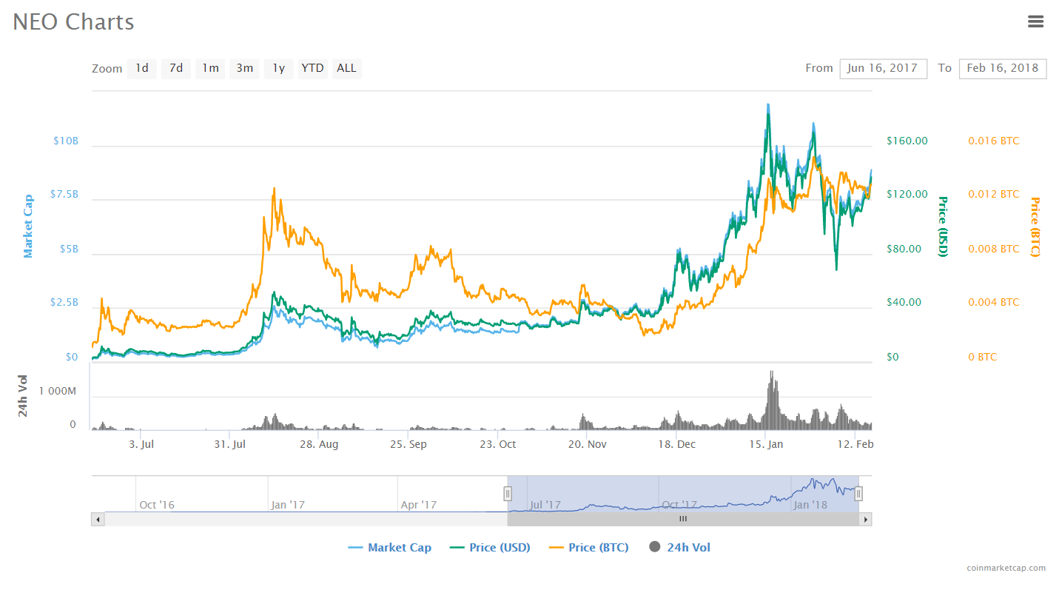
What is NEO?
PROJECT: NEO (https://neo.org/) is a non-profit, community-based blockchain project that utilizes blockchain technology and digital identity to digitize assets, to automate the management of digital assets using smart contracts, and to realize a "smart economy" with a distributed network.
CRYPTOCURRENCY: $NEO
SOFTWARE PLATFORM: Programmable Smart Contract blockchain platform
Multiple languages: C# (reference implementation), Python, Java, Golang, JavaScript
GLOBAL COMMUNITY
Discord: https://discord.gg/gqCYeup (like Slack)
City of Zion “Home of the Open-source Global NEO Developer Community” https://cityofzion.io/

Slide 7



What is NEO?
Digital Assets
+
Smart Economy
Digital Identity
+
Smart Contracts

Slide 8
Why haven’t we entered the era of Smart Economy yet?
How much would you use WhatsApp if you had to pay each time you sent a message?
How much would you use Facebook if you had to pay each time you wanted to watch your friends updates?
The above is how other blockchain platforms are structured today!

Slide 9
The Problems with PoW* and PoS*
This structure is however in direct conflict with the interest of decentralized applications.
Many large scale applications need the transactions to be free of charge for the end user, while still ensuring stable service (transaction time). This will always be a conflict of interest for PoW and PoS systems.
Block creators are incentivized by economic rewards
If a transaction do not include a transaction fee, then the block creators have no interest in resolving it.
This is just how PoW and PoS has to be structured. If there is no economic reward in creating blocks, then there will be less nodes participating in the network, directly influencing network security.
*PoW - Proof of Work
*PoS - Proof of State

Slide 10
NEO is created for large scale dApps*
Mainchain speeds
NEO 1000 – 10,000 TPS (single core)
BTC 3 – 4 TPS
ETH 10 – 20 TPS
No transaction fees Initial 10 GAS fee is for free. Simple Smart Contracts can be run for free.
More freedom to application developers to choose the business model that are most suitable to their business. Service and usage fees can be charged in any way off-chain.
Confirmations needed
NEO 1 and only 1
BTC 6+
ETH 20+
*dApps – Distributed Apps

Slide 11
System Fees
 | NEO [Gas] |  |  | NEO [Gas]
Runtime.CheckWitness | 0.2 |  | OpCode.PUSH16 [or less] | 0.00
Blockchain.GetHeader | 0.1 |  | OpCode.NOP | 0.00
Blockchain.GetBlock | 0.2 |  | OpCode.APPCALL | 0.01
Blockchain.GetTransaction | 0.1 |  | OpCode.TAILCALL | 0.01
Blockchain.GetAccount | 0.1 |  | OpCode.SHA1 | 0.01
Blockchain.GetValidators | 0.2 |  | OpCode.SHA256 | 0.01
Blockchain.GetAsset | 0.1 |  | OpCode.HASH160 | 0.02
Blockchain.GetContract | 0.1 |  | OpCode.HASH256 | 0.02
Transaction.GetReferences | 0.2 |  | OpCode.CHECKSIG | 0.10
Account.SetVotes | 1 |  | OpCode.CHECKMULTISIG [per signature] | 0.10
Validator.Register | 1000 |  | Other OpCodes | 0.001
Asset.Create （system asset） | 5000
Asset.Renew （system asset） | 5000
Contract.Create | 500
Contract.Migrate | 500
Storage.Get | 0.1
Storage.Put [per KB] | 1.0
Storage.Delete | 0.1
Other OpCodes | 0.001

Slide 12
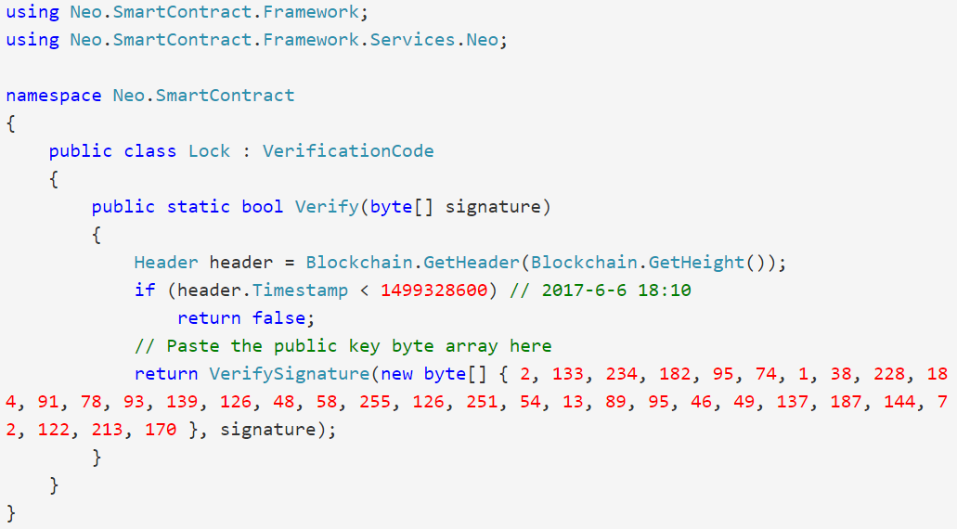
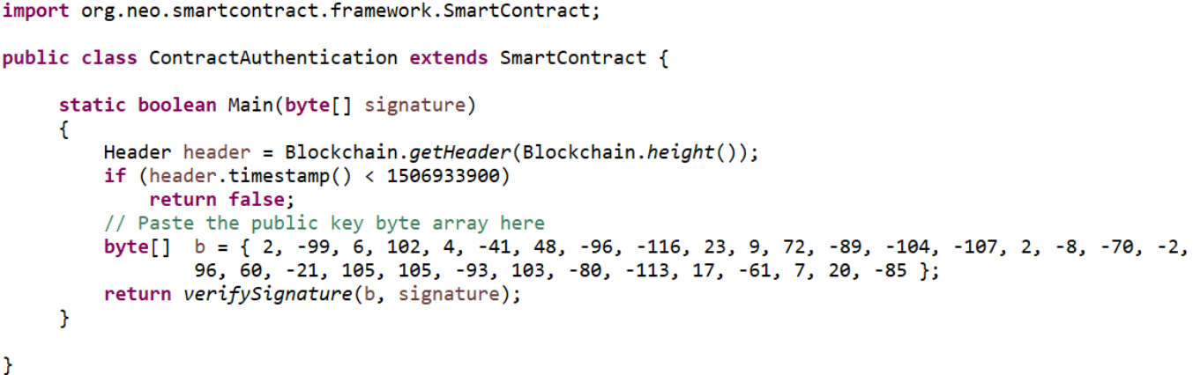
Smart Contracts: “Have it your way”

Slide 13




NeoX: Allowing Private-Public Exchanges
ONT
DNA
ONT
ONT
DNA
DNA

Slide 14
What is NEO? Summary
For large scale decentralized applications, transaction cost, transaction time (including confirmations) is a big obstacle and restriction to possible business models.
NEO is built for large scale dApps and is free to use for the end user. Fees (GAS) are instead charged for deploying contracts and registering assets.
Transaction volume is not an issue with 1000TPS+ on main chain and plenty off-chain scaling possibilites.
NeoX will make the NEO ecosystem quite unique. NEO contain the public ledger for digital assets, identity and smart contracts.

Slide 15
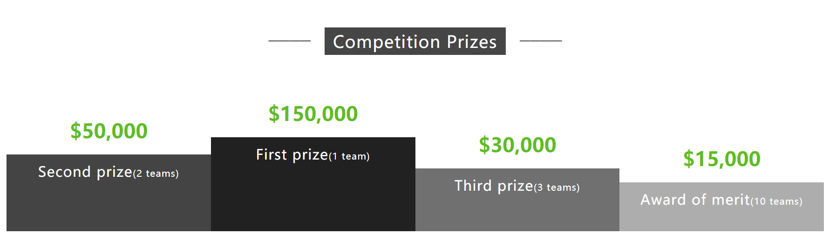
Competition http://www.neo.org/competition.html

Slide 16
City of Zion (CoZ) https://cityofzion.io/
“Home of the Open-source Global NEO Developer Community”
We are an independent group of open source developers, designers and translators formed to support the NEO Blockchain core and ecosystem.
City of Zion Repository https://cityofzion.io/
City of Zion Projects
TODO

Slide 17
How to a join CoZ?
The community (and acceptance) into the community is based on the principle of “doers”.
mwherman2000 – February 21 at 7:57 AM
The CoZ community is based on this deeply engrained principle of "doers"
...you don't ask to do a project, or propose a project or anything like that.
…just "do it" and if CoZ thinks it's non-trivial and that you have been contributing to the NEO community, you may get invited to fork your project over to CoZ and become an official CoZ Developer.
...so just start doing ☺
When you are invited to join, we want to you continue to “do what you’re already doing” as well as contribute to developing the broader CoZ/NEO community.

Slide 18
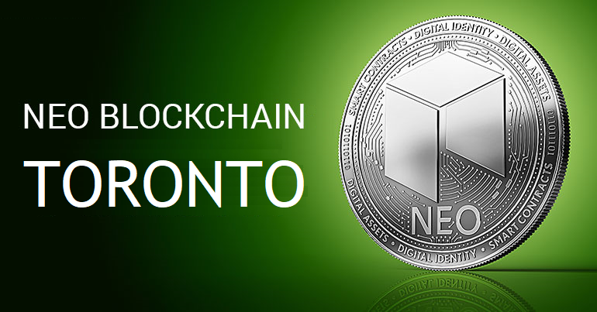
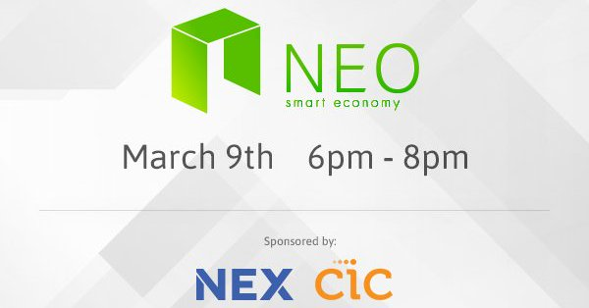

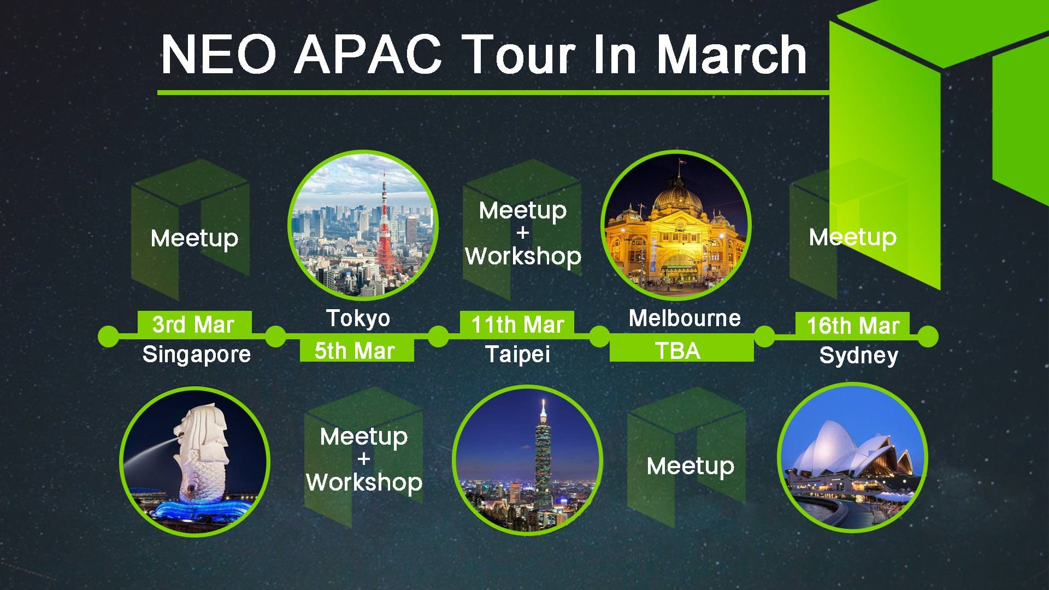
NEO Events
Second Wednesday evening of each month
HackCU Episode IV · University of Colorado Boulder
600 Hackers · 24 Hours · February 24th and 25th 2018

Slide 19
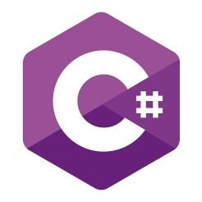



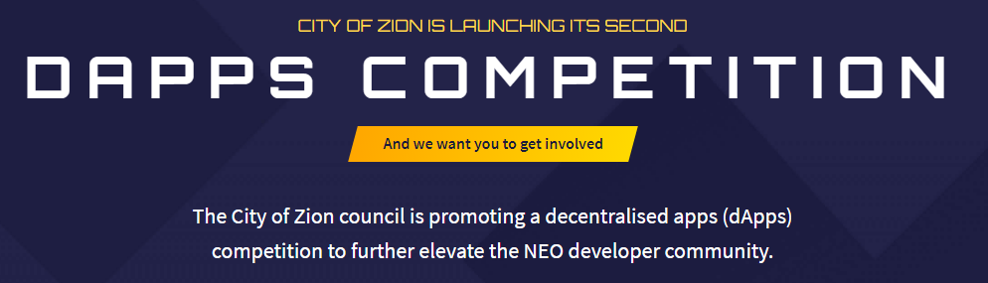

NEO dApp Competitions ~$50K in prizes

Slide 20
NEO News
Who is switching to NEO?
TODO

Slide 21
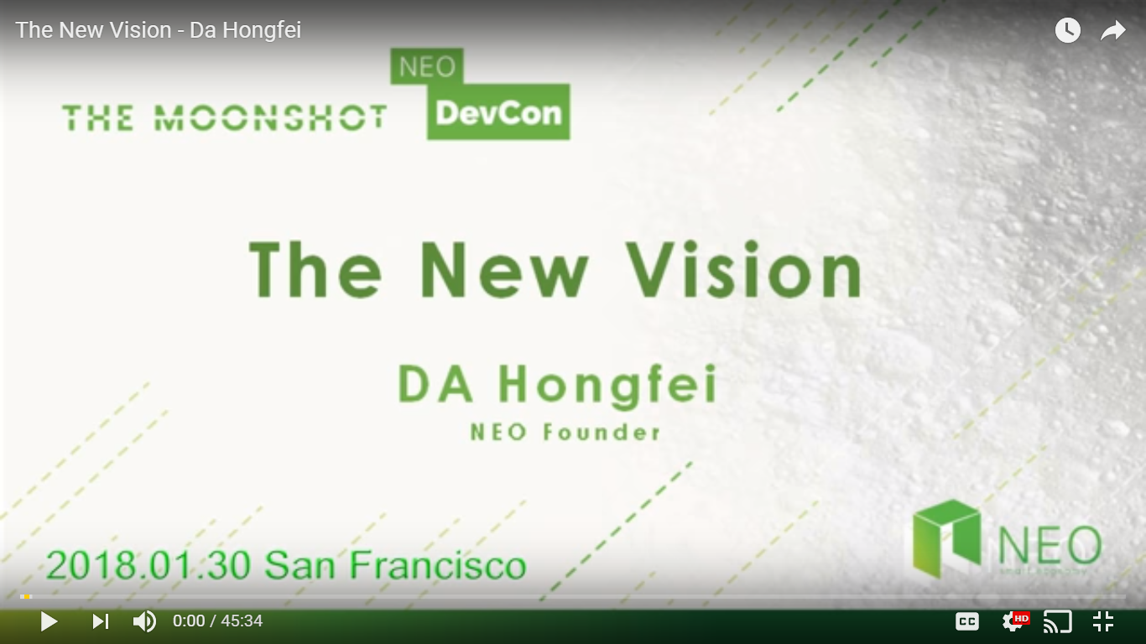
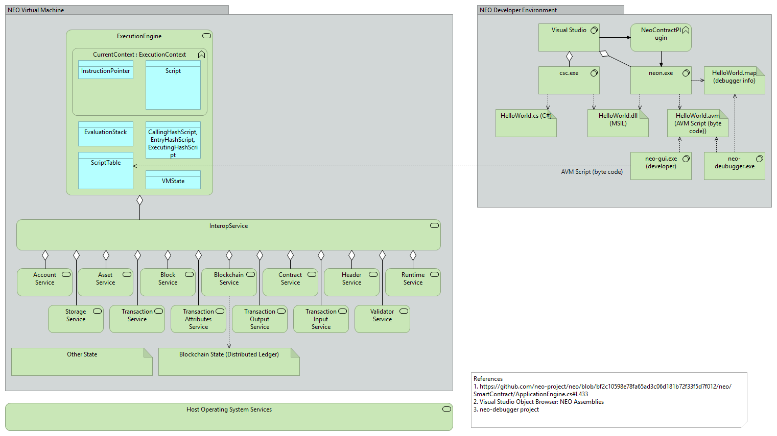
NEO Resources
General
NEO.org http://neo.org
NEO Tutorials (C#, Java, Python), API docs http://docs.neo.org
NEO Devcon “Th New Vision” Keynote by NEO Founder https://www.youtube.com/watch?time_continue=3&v=th7jZlmoZBc
Developers
NEO Blockchain developer guidance for Microsoft .NET developers (neo-windocs) https://github.com/mwherman2000/neo-windocs
City of Zion awesome-neo project: Developer Docs https://github.com/CityOfZion/awesome-neo/ #developer-documentation
The NEO Project https://github.com/neo-project
Discord NEO Community (like Slack) https://discord.gg/gqCYeup

Slide 22
neo-windocs Project https://github.com/mwherman2000/neo-windocs
Founder: Michael Herman (neotoronto@outlook.com)
NEO Blockchain end-to-end, detailed guidance for .NET developers
Content purposely designed to help .NET developers ramp up and become productive more quickly
Repository for content presented at the NEO Blockchain Cleveland meetup group
Contents
NEO Blockchain Quick Start Guide for .NET Developers https://github.com/mwherman2000/neo-windocs/tree/master/windocs/quickstart-csharp/README.md
NEO Blockchain Architecture Reference Model (ARM) for .NET Developers (neo-charm) https://github.com/mwherman2000/neo-windocs/blob/master/windocs/neo-charm/README.md
NEO Blockchain Cleveland Meetup https://github.com/mwherman2000/neo-windocs/tree/master/events/2018-neo-blockchain-cleveland

Slide 23
NEO Blockchain Quick Start Guide for .NET Developers https://github.com/mwherman2000/neo-windocs /blob/master/windocs/quickstart-csharp/README.md
Pre-requisites and Recommendations
Download and install Visual Studio 2017 Community Edition integrated development environment (IDE)
Download and unpack NEO developer tool projects (source)
Coffee time: Wait for previous activities to complete
Install NeoContractPlugin Visual Studio extension
Build and test NEO developer tool projects (from source)
Download, install, and test Docker platform
Download and test NEO privatenet Docker container
Create and compile HelloWorld smart contract sample
Deploy and test the HelloWorld smart contract
Celebrate
Appendix A - Checklist
Appendix B - Roadmap
Appendix C - Reset NEO privatenet Environment: Container, Wallets, and Clients
Statistics
10 activities comprising 130 documented tasks (approximately)
140 screen shots (approximately)
7 batch files
2 JSON configuration files
1 C# code snippet

Slide 24
NEO Blockchain Architecture Reference Model (ARM) for .NET Developers (neo-charm) https://github.com/mwherman2000/neo-windocs/ blob/master/windocs/neo-charm/README.md

Slide 25
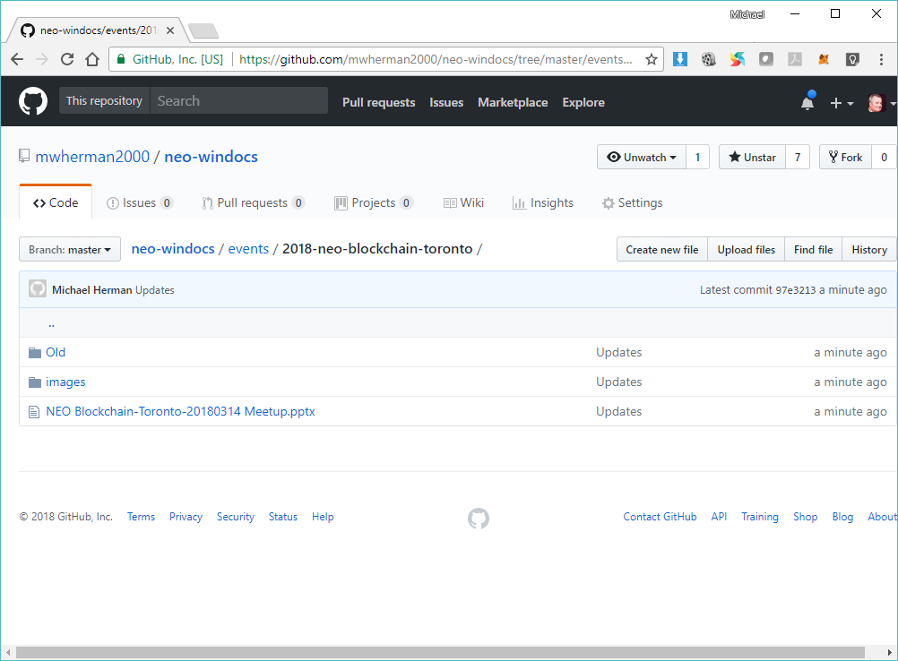
NEO Blockchain Cleveland (@neotoronto) https://github.com/mwherman2000/neo-windocs/ tree/master/events/2018-neo-blockchain-cleveland

Slide 26
Our Values as Neoxplorers
We operate like a blockchain
Decentralized
Community based
Consensus driven
Creators of value
Store value
Transfer value
Multi-disciplinary
Multi-application
Multi-technology
Multi-industry
We behave like a blockchain
Robust
Reliable
Transparent
Smart
Open
Non-discriminatory
Participatory
Diverse
Committed
Watching out for the next person

Slide 27

Thank you for coming out this evening
Happy St. Patrick’s Day
Neoxplorers!
Meetup the second Wednesday evening of each month:
April 11, May 9, June 13

Slide 28
Backup Slides

Slide 29
NEO Blockchain CLEVELAND
Welcome Neoxplorers!
“Genesis Block 0” Meetup – March 24, 2018
https://www.meetup.com/NEO-Blockchain-Cleveland/
neotoronto@outlook.com

